Slide 1
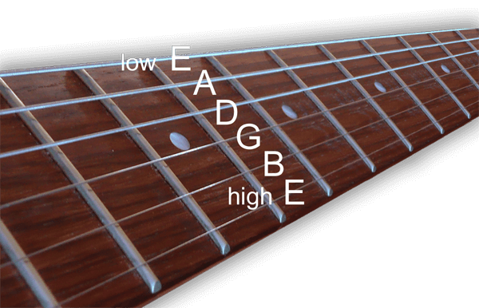
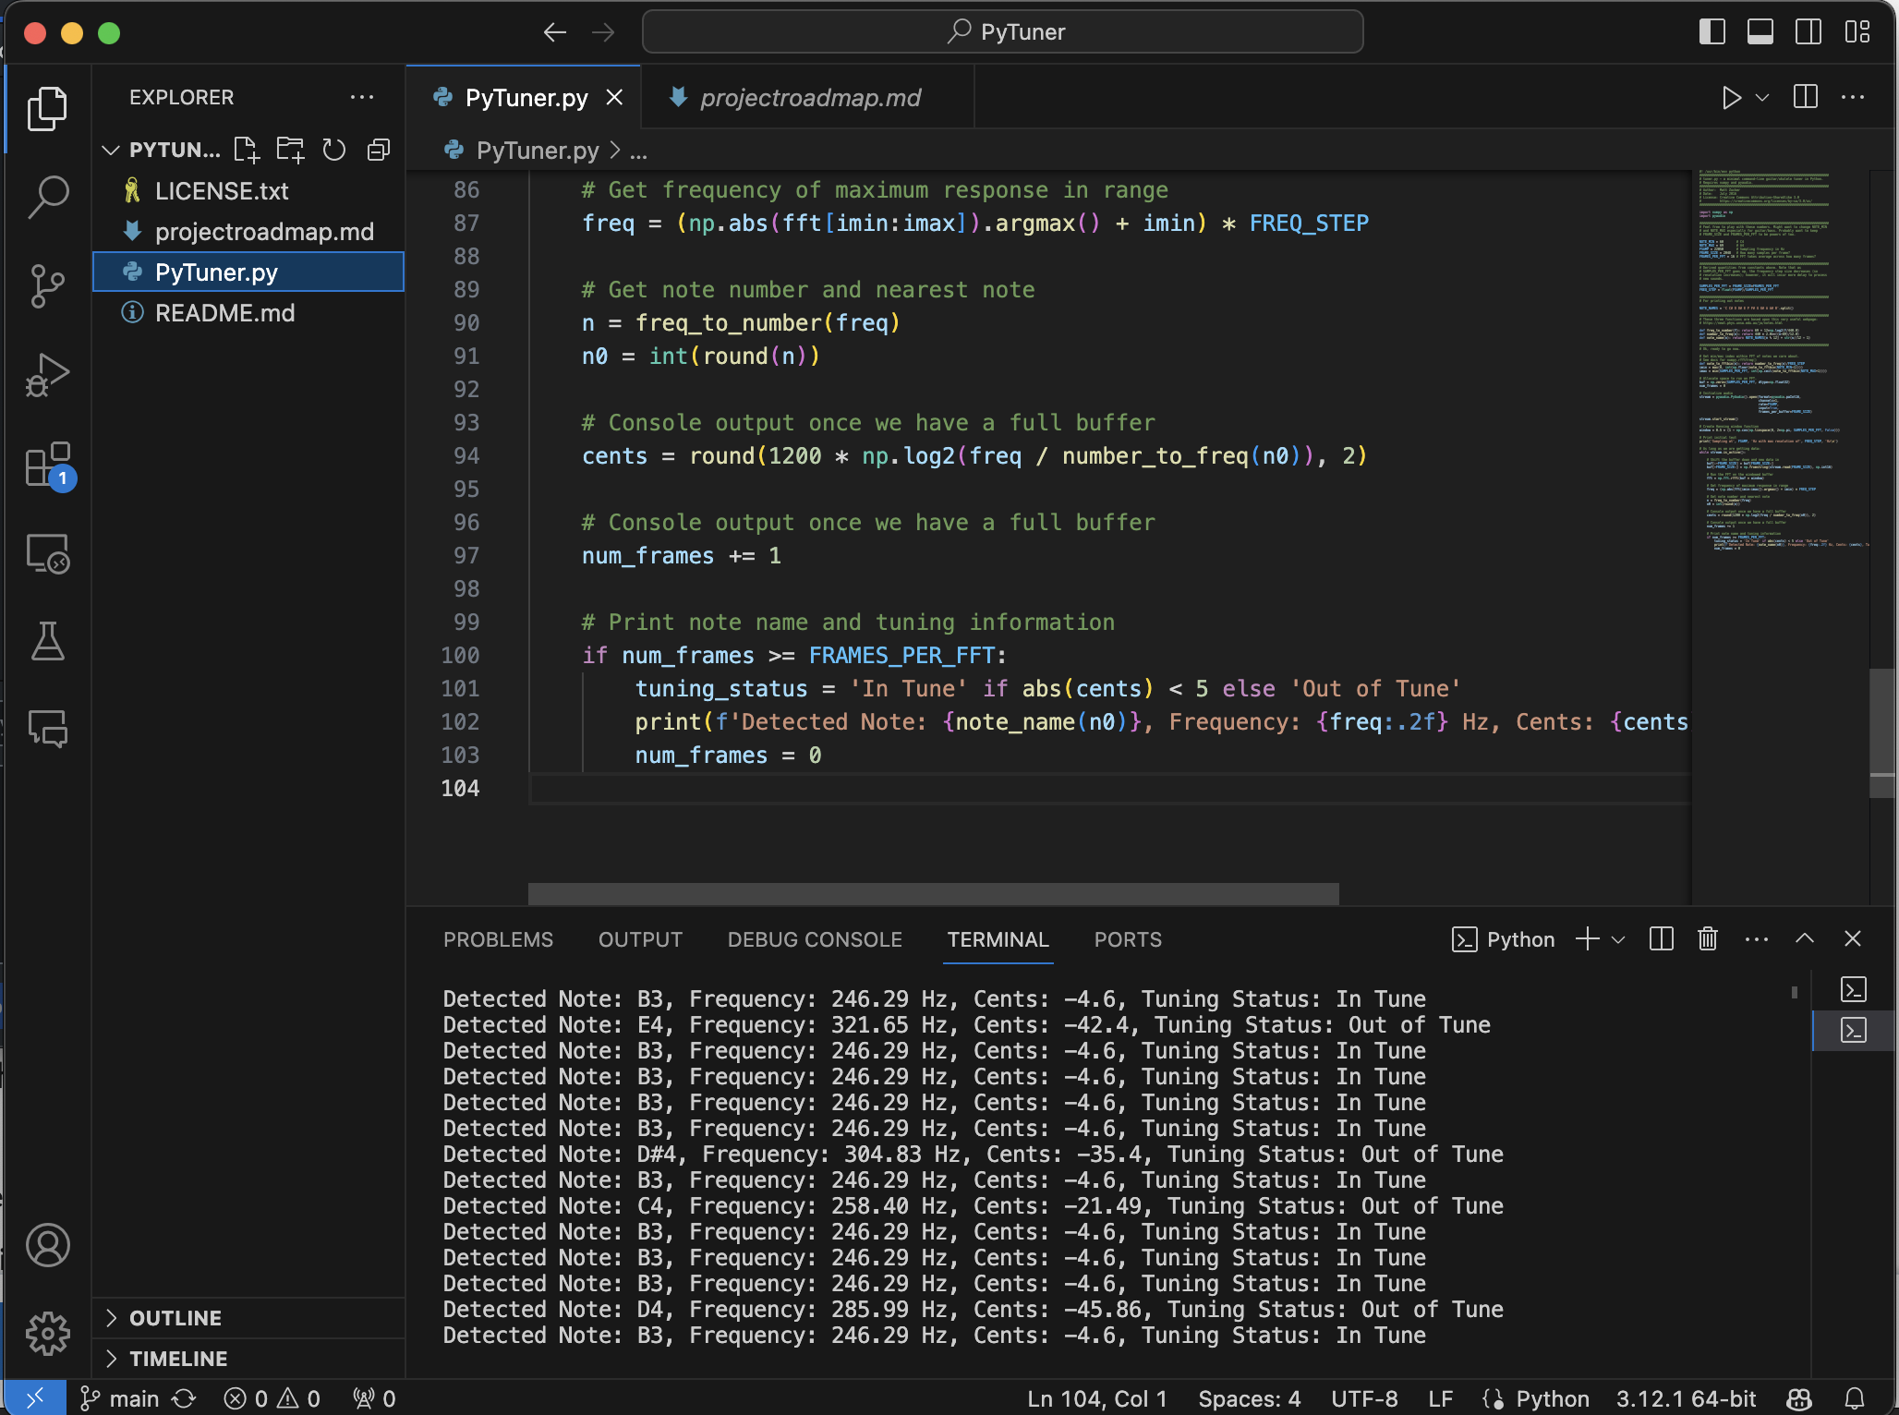
PyTuner
A simple terminal-based application that allows users to tune their guitar using their device's microphone. The system recognizes the pitch of a note and displays the note name, Hz, cents, and whether the note is in tune.
Coder: Lane Reinhardt
GitHub Repository: https://github.com/ksu-is/PyTuner/tree/main
Originally Forked From: https://github.com/mzucker/python-tuner

